Slide 1




Learning Enhancement using AI – SAFEGUARDING CHILDREN
Muneeba Nawaz
Susan Dangana
Paul Slevin
Olumuyiwa Olajuwon
Michael Patrick
Ademola Oladimeji
Madhav Thodindala

Slide 2

Project Aims and Objectives
The aim of this analysis is to help our client extract valuable insights from the provided dataset using NLP techniques - text summarization, NER, and word frequency analysis.
To distil complex information into actionable insights that can guide decision-making processes and interventions aimed at protecting vulnerable populations.
To automate the current process of translating raw learning materials into the new course with a focus on SAFEGUARDING CHILDREN.

Slide 3

OUR THOUGHT PROCESS
NLP TECHNIQUES APPLICATION
INSIGHTS AND RECOMMENDATIONS
COMMON THEMES Extraction

Slide 4
COMMON THEMES EXTRACTION
Common Themes | Number of Mentions
October 2014 | 11
1989 | 4
Section 47 | 3
Children Act | 2
Age 1618 | 2
UK | 2
Family Solutions | 2
Essex | 2
IRT | 2
999 | 2
CQC | 1
Foster | 1

Slide 5
TEXT SUMMARIZATION
Overall, the summarization process effectively condenses the original text into key points related to service provision, referral pathways, identification of issues impacting families, understanding the impact on children, availability of specialist services, acknowledgment of uncertainties, and adherence to legal frameworks. This condensed information can be valuable for professionals involved in child protection and welfare services, facilitating better understanding and decision-making in safeguarding children.

Slide 6
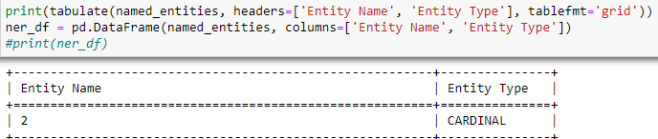

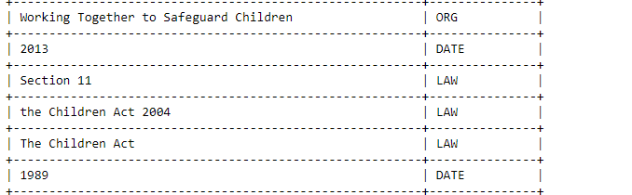
NAME ENTITY RECOGNITION

Slide 7
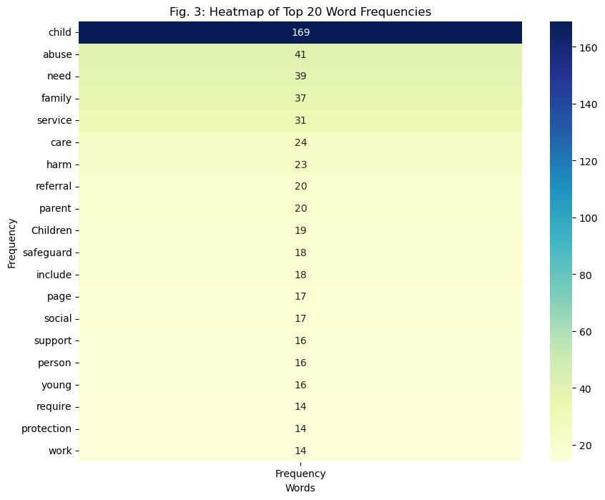
WORD FREQUENCY

Slide 8

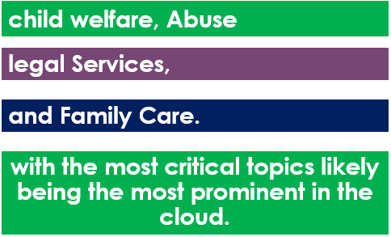
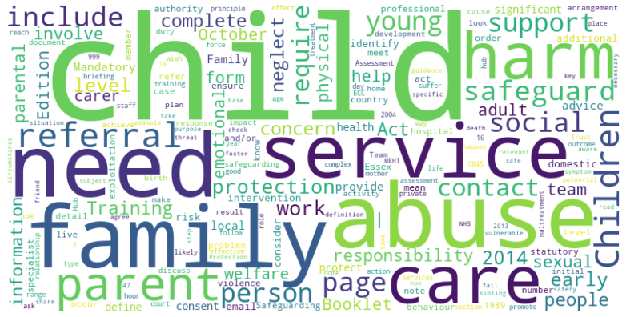
WORD CLOUD
This visual shows the primary focus areas of this work -

Slide 9
Automate The Process.
Enhance efficiency by lowering costs and increasing resource availability.
Human-like text Generation that includes articles, stories, and dialogue.
Sentiment Analysis to determine the sentiment or opinion expressed within text.
WHY
NATURAL LANGUAGE PROCESSING
TECHNIQUE

Slide 10
INSIGHTS GATHERED / IMPLICATIONS
Fully automated translation may not always produce perfect results, particularly for complex or domain-specific content.
Focus on Child Welfare: Repeatedly referencing child protection laws, healthcare, and support highlights the importance of prioritizing child safety.
RECOMMENDATIONS
Train domain-specific language models on educational data. These could capture domain-specific vocabulary, syntax, and semantics, leading to better performance.
Integration of sentiment analysis techniques could help assess the emotional tone and implications of the text, enhancing understanding and interpretation.

Slide 11



QUESTIONS

Slide 12
Source image
https://gifer.com/en/gifs/questions
https://davehasney.com/2021/01/15/thought-shaping/
https://sanketbadjate36.medium.com/benefits-that-companies-are-getting-from-ai-ml-7f8b5ce341ed

